Slide 1




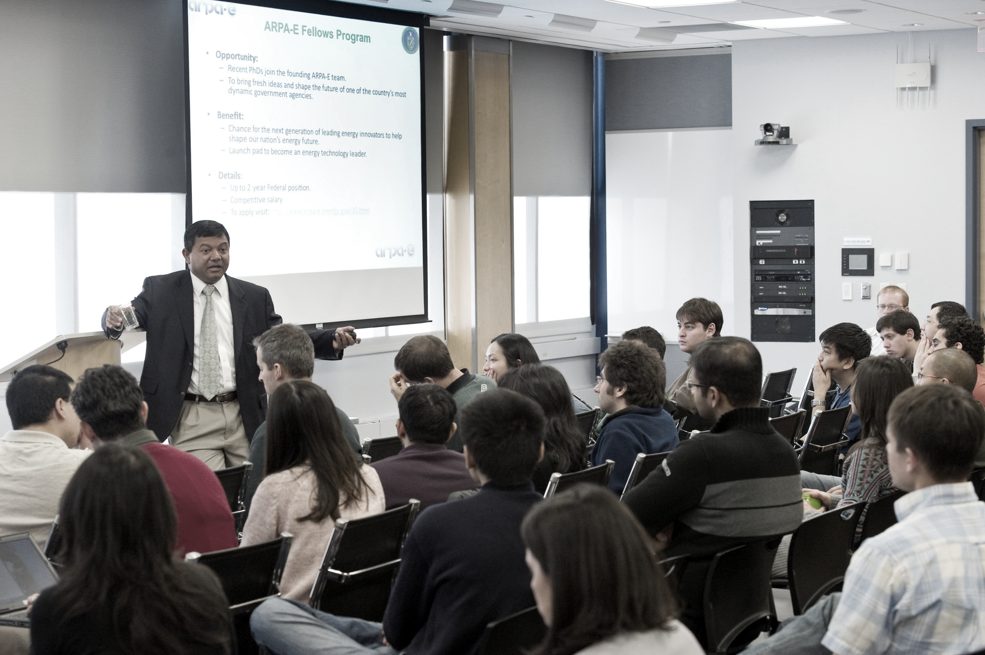


10
Teaching Design
mqf
10
mqf

Slide 2
10
mqf
Teaching context
Teaching objectives
& method
Teaching procedure
10
mqf
Teaching highlights
Teaching presentation

Slide 3





Teaching context
About the text
About the students

Slide 4
About the text
Genre
Main idea
Exposition
The science of helping out
Focal Point:
Feeling responsible for others

Slide 5

About the student
1
1
Strengths
Diligence
Ambition
1
Weaknesses
01
English education
Individual
community
02
Vocabulary: 5000-6000
CSE: 5-6

Slide 6

Teaching objectives & method
Teaching objective
Knowledge
Skill
Value
Teaching method

Slide 7
Teaching objective
Knowledge
01
To identify opinion and facts
To learn ways of illustration in an expository essay

Slide 8
Skill
02
To learn how to express opinion
To apply exemplification in writing

Slide 9
Value
03
To build a sense of respecting others
To deepen the understanding of building a community of shared future for mankind

Slide 10
To build a sense of respecting others
To deepen the understanding of building a community of shared future for mankind
Value
mqf
To learn how to express opinion
To apply exemplification in writing
Skill
To identify opinion and facts
To learn exemplification in expository essay
Knowledge

Slide 11
Teaching method
Task-based approach
Communicative teaching approach

Slide 12
Teaching procedure
Pre class
Task 1
Task 2
Task 3
In-class
Lead-in
Input
Production
Evaluation
Testing
Assignment
Post-class
Task 1
Task 2

Slide 13
Teaching procedure
Pre-class
While-class
Post-class
A theme-based learning environment
What is wisdom?

Slide 14

Pre-class
What makes a wise person?

Slide 15

Pre-class task 1: How to gain wisdom?

Slide 16
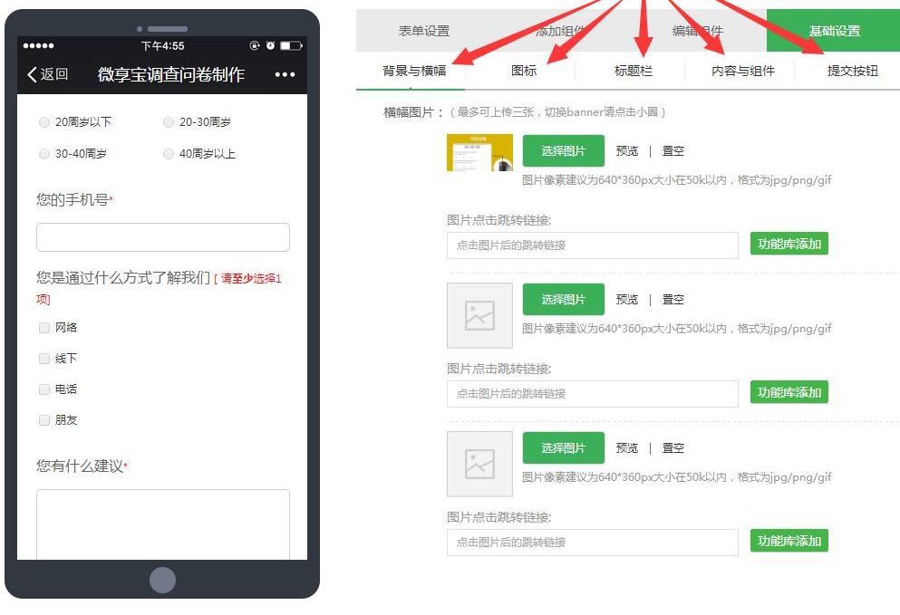
Pre-class task 2: Questionnaire
What is wisdom?

Slide 17

Pre-class task 3: Shoot a macro-class
What is expository text? –Definition; Types & Examples

Slide 18
In class
Assignment
Testing
1min
Evaluation
6min
Production
7min
Input
14min
Lead-in
12min
总计：2课时
5min

Slide 19
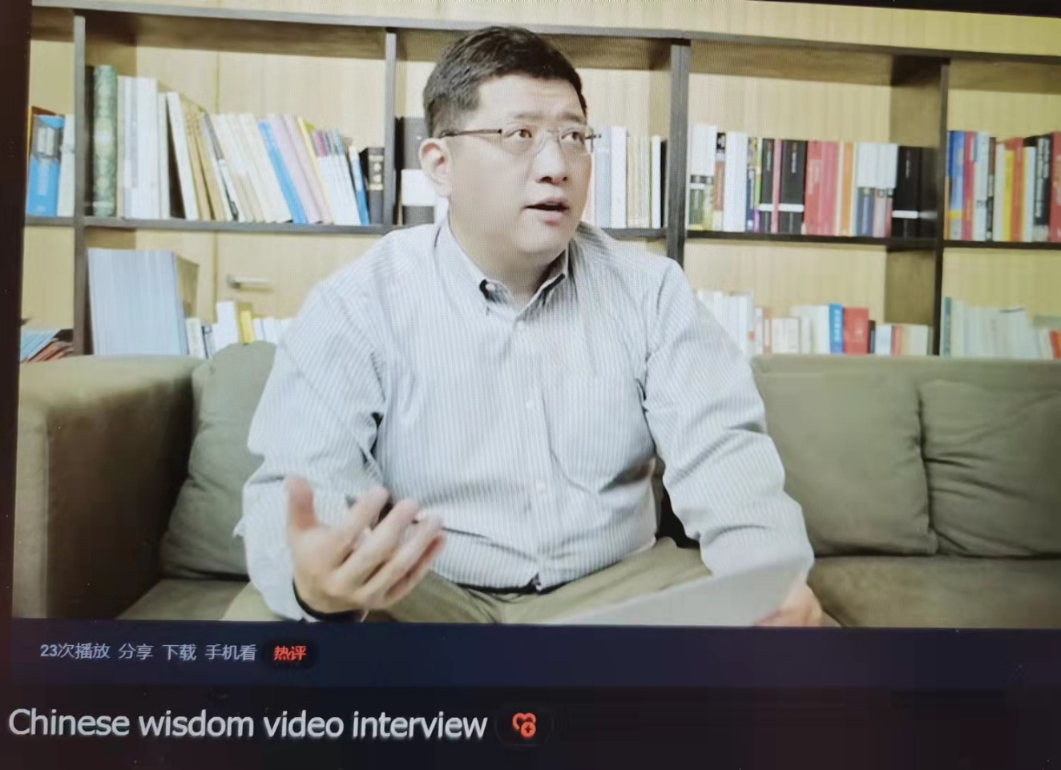
01
Lead-in
Task1
Report about the results of the questionnaire
Task 2
Watch video clip “Chinese wisdom”

Slide 20

01
In-put
Task 1: Thinking and sharing in groups
Answering the following questions：
（1）What is the thesis of the essay?
（2）How does the author develop the essay?
（3）What is wisdom defined by the author?

Slide 21

Task 2:
Discussion on What is your definition of wisdom?

Slide 22

03
Production
Task1
Draw a mind map of the structure of the text
Task2
Presentation on the theme :
To approach impartiality constitutes growth in wisdom

Slide 23
04
Evaluation
Peer evaluation
Self-evaluation
Teacher’s evaluation
Merits
Peer’s advice
Teacher’s advice
Demerits

Slide 24

05
Testing
What is wisdom? Give your definition by making a topic sentence.

Slide 25

06
Assignment
Uploading free writing
Summarize your views on wisdom and Try to define Chinese wisdom.

Slide 26
Post-class
Task1
Research examples in daily life showing Chinese wisdom.
Task2
Try to show your understanding of wisdom by designing a poster on wisdom.

Slide 27
Teaching highlights
I
I
V
Integrated-implicitly
Idea-provoked
Value-specified

Slide 28

Teaching Demo
An Integrated English Course

Slide 29
How to give definition?
Definition
“There are, I think, …The capacity to take account of all the important factors in a problem and to attach to each its due weight.”(Para.2)

Slide 30
Definition of wisdom
Definition
“There must be, also, a certain awareness of the ends of human life.”(Para.3)

Slide 31
Definition of wisdom
Definition
“I think the essence of wisdom is emancipation, as far as possible, from the tyranny of the here and now .”(Para.3)

Slide 32
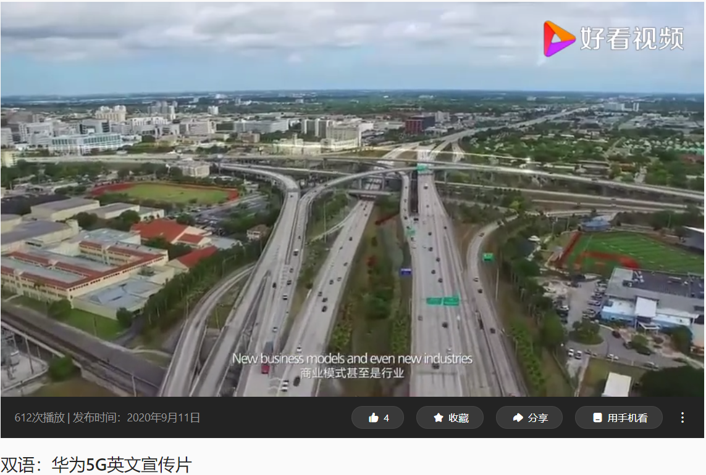
Huawei
Question: How do you understand Huawei’s wisdom?

Slide 33
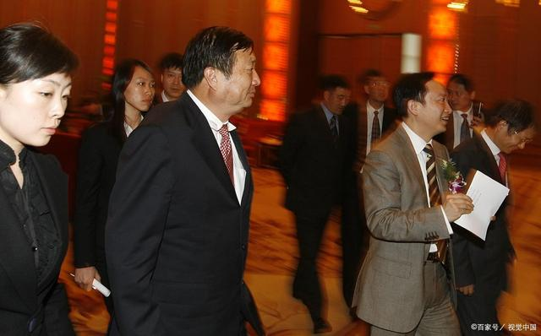
Independent research
任正非对此忧心忡忡地表示：“没有任何一个国家有象中国这么多的交换机生产厂家，各厂家各自为政，很难使国产交换机的整体水平提高档次，也是产生许多短期行为的原因……”

Slide 34

The Belt and Road Initiative
“Increase transparency, expand trade, improve debt sustainability, and mitigate environmental, social, and corruption risks.”

Slide 35
China’s wisdom
谈开放：保护主义如饮鸩止渴
谈合作：伙伴精神是最宝贵的财富
谈发展：竭泽而渔式的发展不会长久
谈创新：打开增长之锁的钥匙
谈落实：成为行动队而不是清谈馆

Slide 36
mqf
Thank You!

